Slide 1
Plant/harvest validation with Matopiba
August 3, 2018

Slide 2
Plant/Harvest date estimation

Slide 3
In GEE: Timeseries Validation w Matopiba v3
Cleaned up the repetitiveness of charting and cleaning data by adding new functions
In GEE: Timeseries Validation w Matopiba v4
Masked out pixels with quarter period outside of 10-70 day range and did analysis for only those pixels (only one or two polygons were taken out because they had nothing within them that had a pixel with ok quarter period

Slide 4
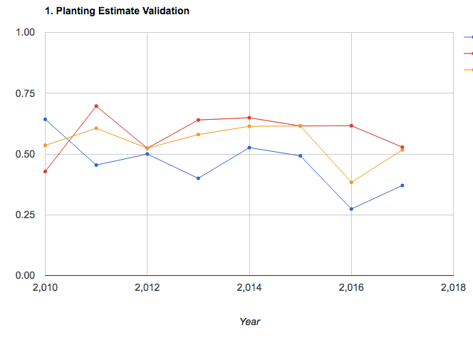
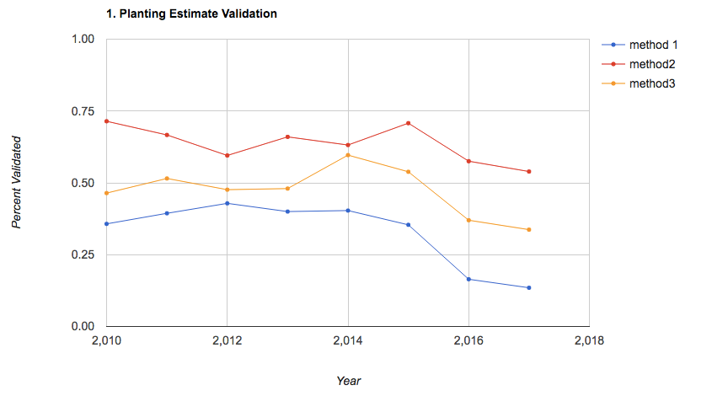
No masking of quarter period, vs masking bad pixels (but not entire polygons based on bad pixels, unless there are NO good pixels in polygon) – done in GEE file Timeseries Validation w Matopiba v4
No masking
Masking of bad pixels
Method 2 had slight improvement

Slide 5
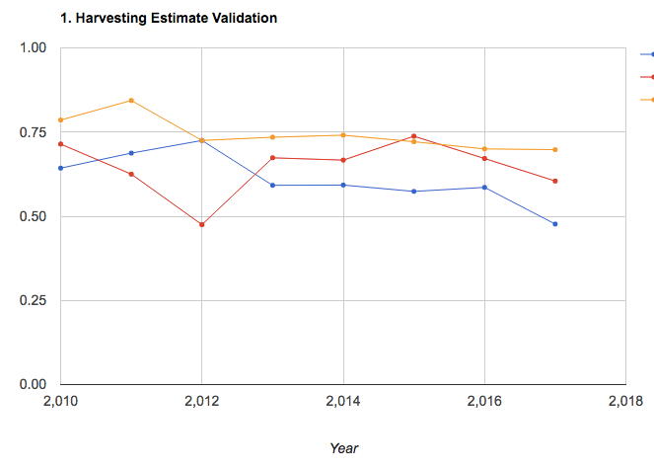
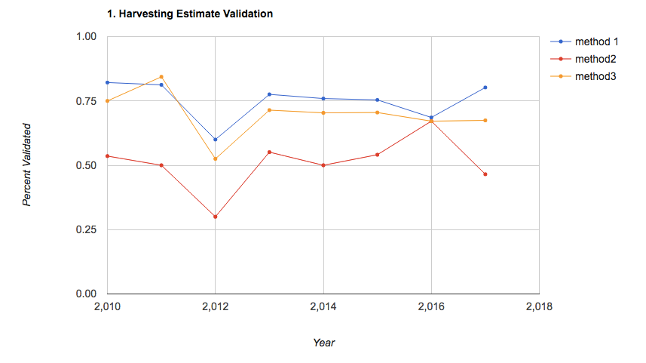
No masking
Masking of bad pixels
The best performing method didn’t really improve

Slide 6
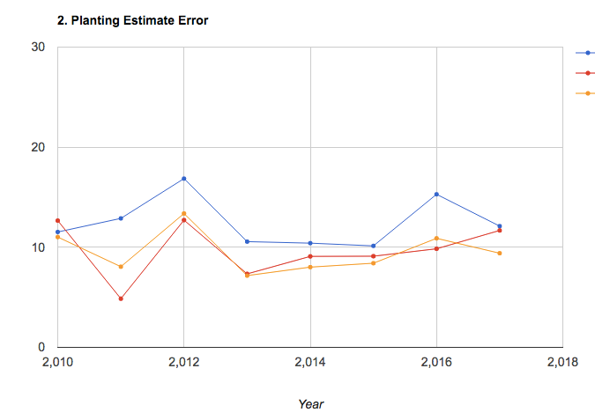
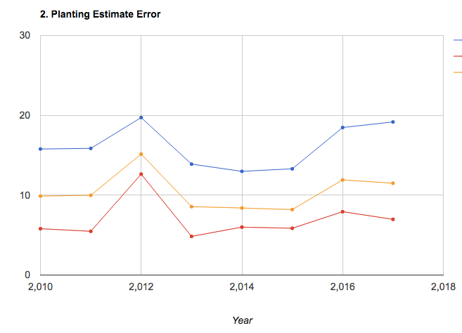
No masking
Masking of bad pixels
Method 2 didn’t improve by much, but there’s a slight improvement

Slide 7
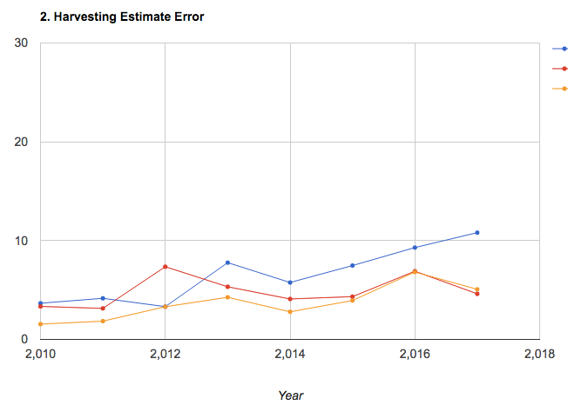
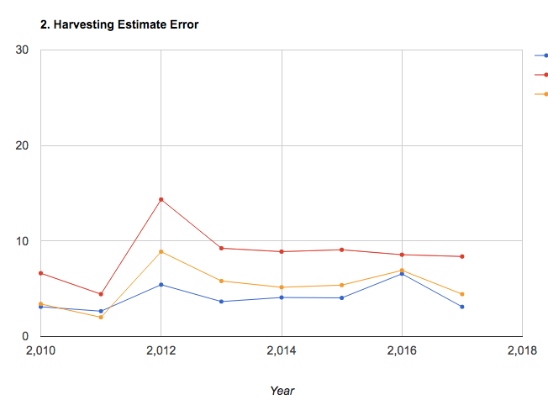
No masking
Masking of bad pixels
In general, method 2 got worse but method 1 bot a lot better.
The best methods perform about the same

Slide 8
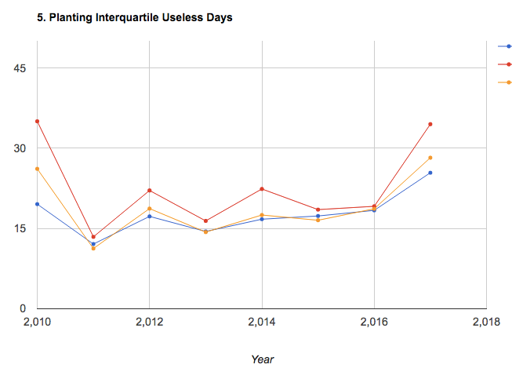
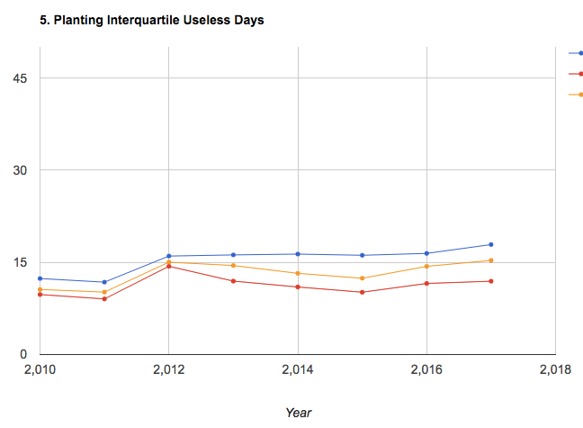
No masking
Masking of bad pixels
Method 2 (red) got a lot better for planting – naturally, because range is smaller (probably)

Slide 9
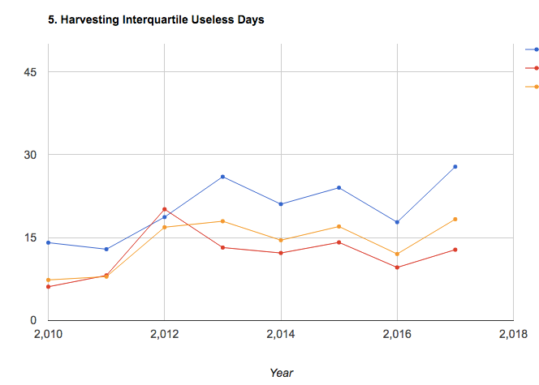
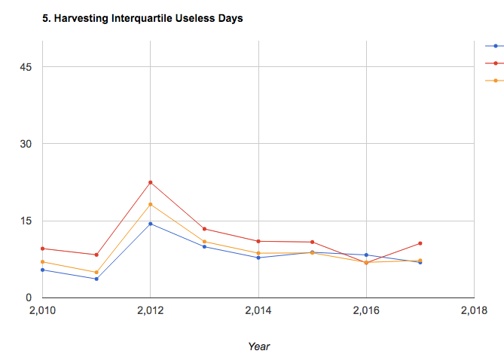
No masking
Masking of bad pixels
Method 1 (blue) got a lot better – in general, useless days decreased

Slide 10
In GEE: Timeseries Validation w Matopiba v5
Put in a chart to look at 0, 25, 50, 75, 100th percentiles of each polygon’s pixel-level estimates and compare that to reported plant/harvest dates
In GEE: Timeseries Validation w Matopiba v6
Add a way to delete an entire polygon from consideration if a certain % of its pixels have bad quarter period estimates
Upon closer inspection of individual pixels (and the patchy nature of bad quarter periods over space), and looking at the matopiba reports of whether a farm has natural vegetation, and the agricultural area vs total area, likely that lots of natural vegetation are biasing our estimates by biasing quarter period.
Conclusion: don’t get rid of polygons with a certain % of bad pixels; because then we’ll be getting rid of most farms. This is because most farms have significant natural vegetation within their bounds. Perhaps it’s a better idea to just get rid of the individual pixels in the polygon.
Found no correlation between % area of bad quarter period pixels and % area of agri pixels in each polygon… why not? Can we have a new measure comparing the overlap between my bad quarter period and Jake’s agri pixels?
Found no correlation between error and percent agricultural area in a polygon… so where is the error coming from? Need to look at specific polygons.
Using only Jake’s agri pixels improved average performance, but not by much, and there are still very extreme errors. Perhaps this indicates errors in Jake’s agri classification, or errors in my peak estimates. Need to look at the specific polygons.
Note: bands in an image don’t have the same mask; need to go for ‘plantDate_1_millis’, etc band to get the mask

Slide 11
Summary of what’s been found for plant/harvest validation this week:
Noticed that getting rid of bad quarter period pixels helped with range performance metrics and a little bit with rmse metric, but still had a lot of points with very significant error (like, 100 days)
Also tried to get rid of entire polygons with a certain % of “bad quarter period pixels”, but most of the polygons would be gotten rid of at even 70% bad pixel threshold, and this discovery led to another…
A lot of the polygons/fields had a lot of natural vegetation, according to Matopiba survey and according to Jake’s land classification – and perhaps my bad quarter period pixels aren’t a good way to separate agri from natural veg pixels
Tested whether bad quarter period pixels correspond to Jake’s natural veg pixels by plotting correlation between their respective percent areas – found some correlation, but not perfect. Perhaps also relate Jake’s agri map to Matopiba reported percent natural vegetation, because Jake’s agri might also have errors.
There was very low correlation between the quality of the estimate and the percent of natural agri from Jake’s map and the percent of bad quarter period pixels
Also tried to only take pixels that are classified as Jake’s agri in order to estimate, and range-related errors are generally better than with taking out bad quarter period pixels alone; but rmse and percent validated didn’t improve – so range is smaller, but central tendency didn’t improve
Even with taking out bad quarter period pixels and only getting Jake’s agri pixels, there are still polygons with significant error. Need to take a close look at them to see what’s going on.

Slide 12
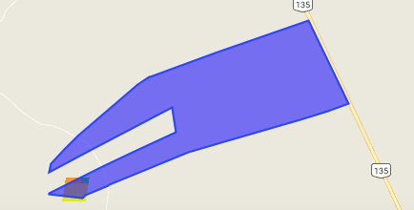
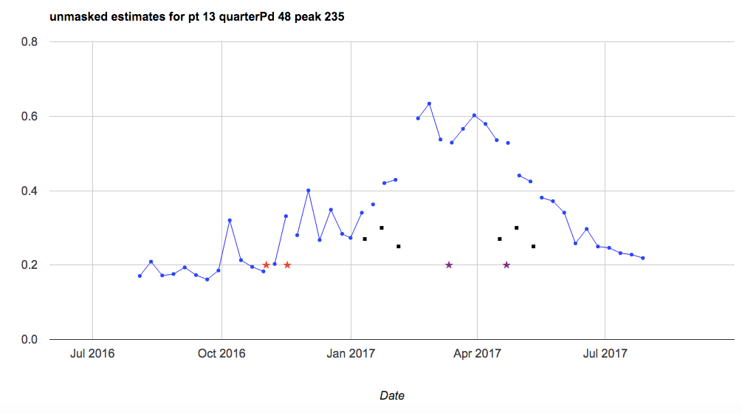
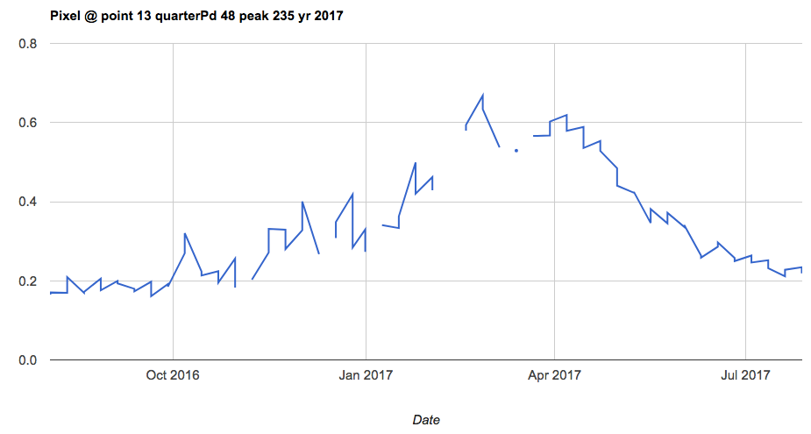
Bad polygon: pt 13, year 2017 (10 – 70 quarter period included, only Jake’s agri included)
Plant error: + 55

Slide 13
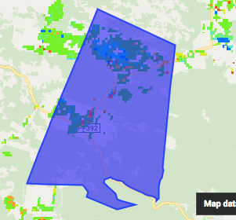
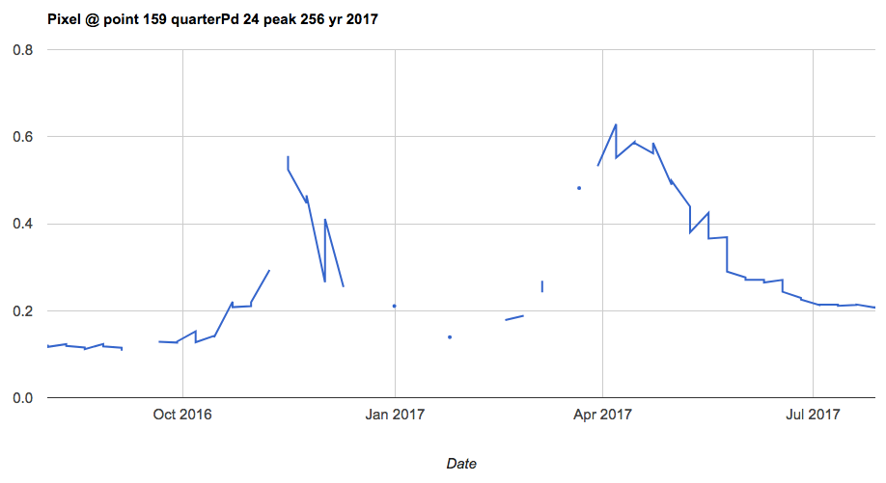
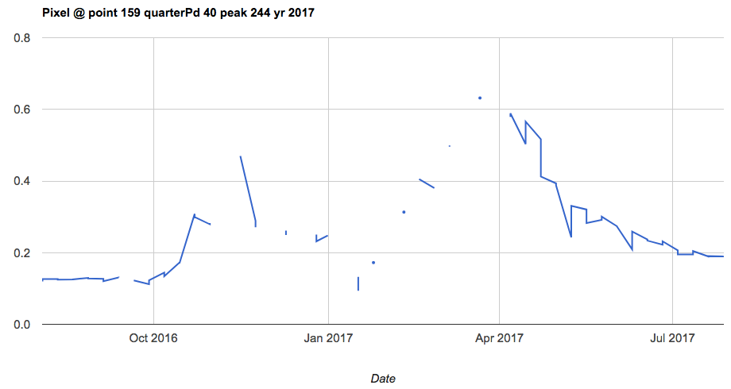
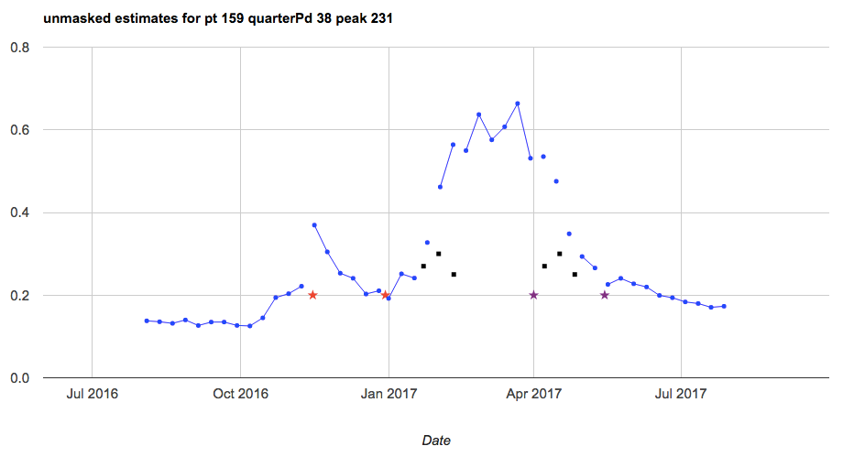
Bad polygon: pt 159, year 2017 (10 – 70 quarter period included, only Jake’s agri included)
Plant error: +23

Slide 14
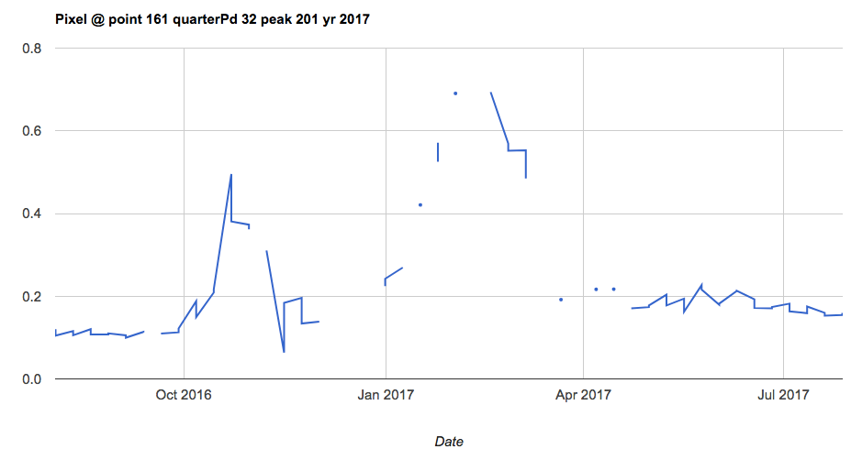
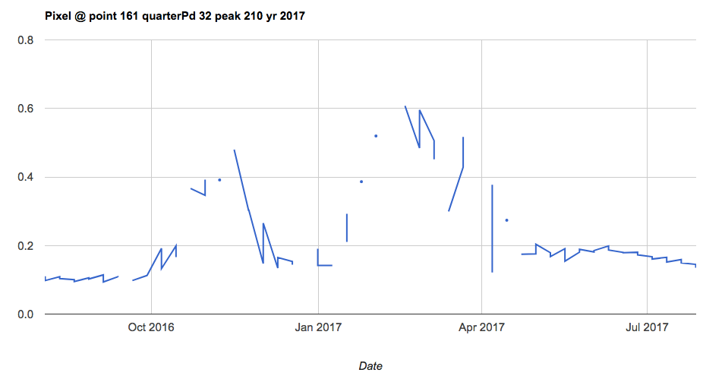
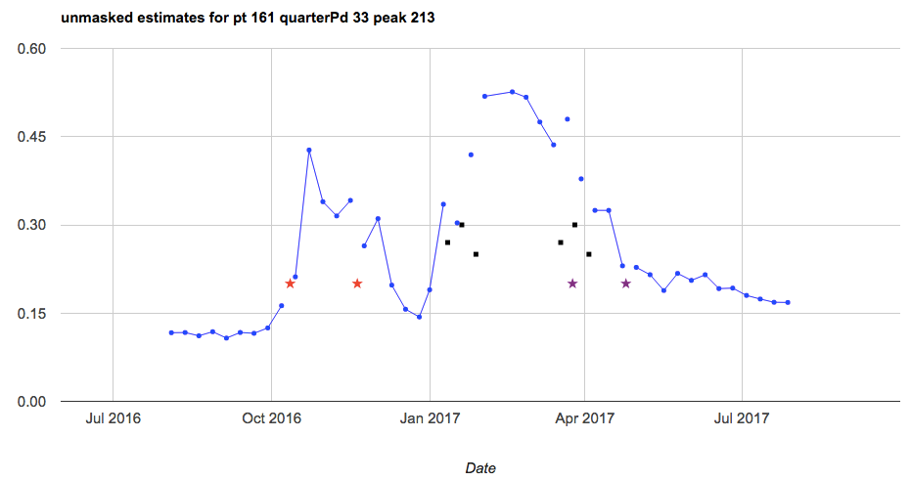
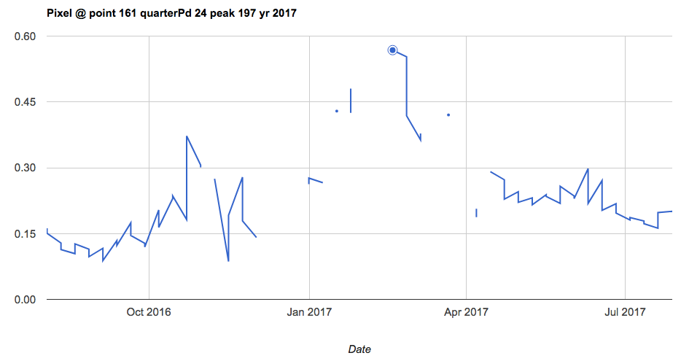
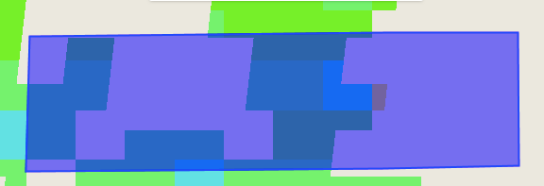
Bad polygon: pt 161, year 2017 (10 – 70 quarter period included, only Jake’s agri included)
Plant error: +91

Slide 15
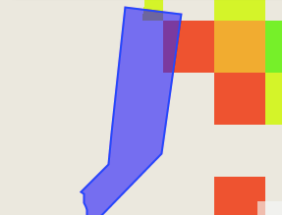
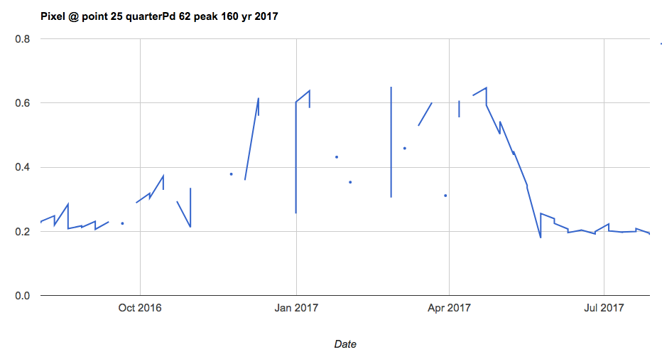
Bad polygon: pt 25, year 2017 (10 – 70 quarter period included, only Jake’s agri included)

Slide 16
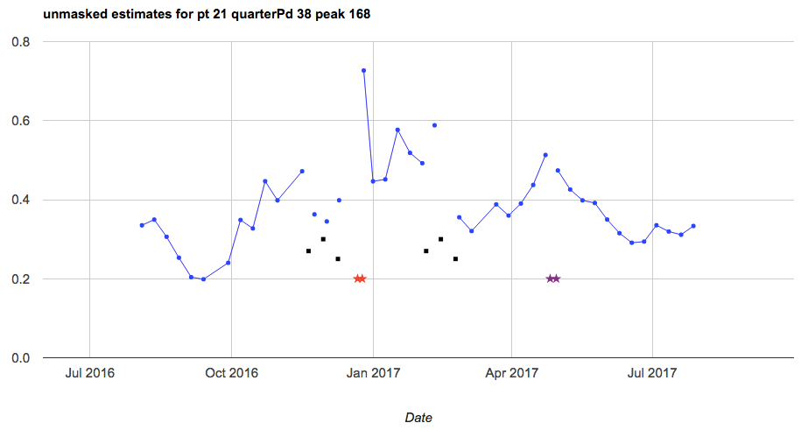
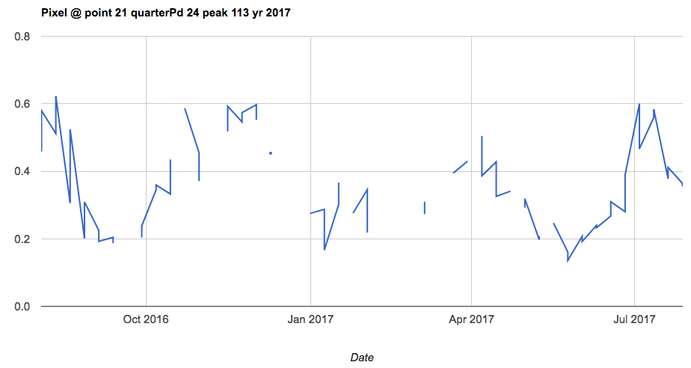
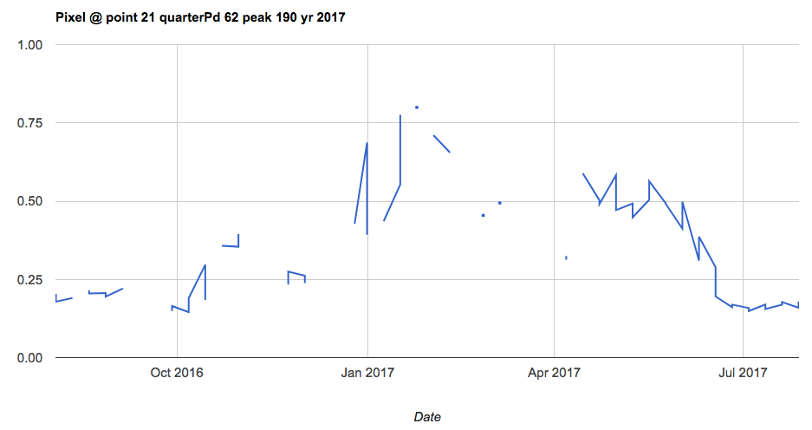
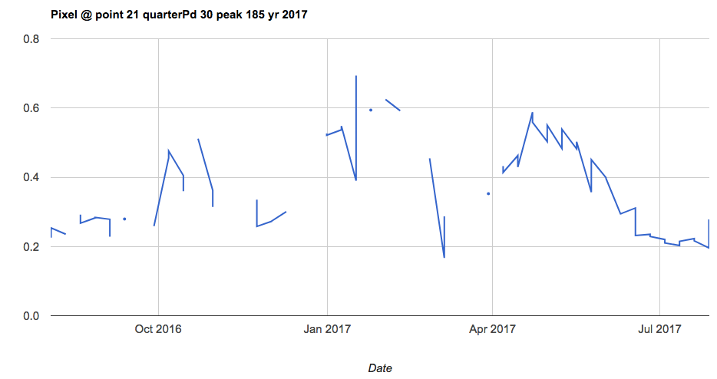
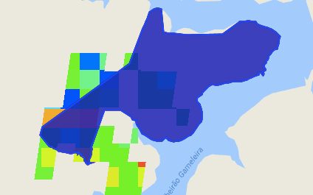
Bad polygon: pt 21, year 2017 (10 – 70 quarter period included, only Jake’s agri included)
Plant error = -31

Slide 17
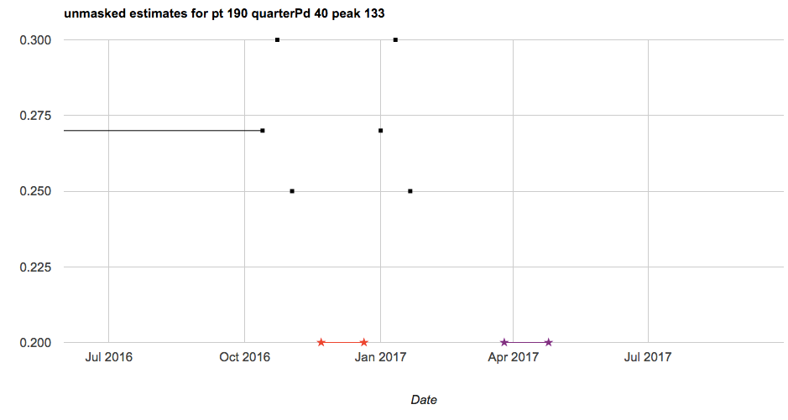
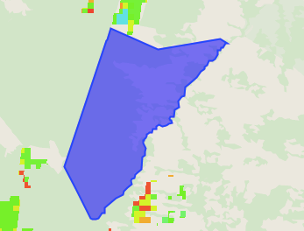
Bad polygon: pt 190, year 2017 (10 – 70 quarter period included, only Jake’s agri included)
Plant error = -39

Slide 18
Bad polygon: pt 190, year 2017 (10 – 70 quarter period included, only Jake’s agri included)

Slide 19
Next:
Look at performance of estimates/% of bad pixels in polygon wrt reported total area vs. agricultural area in the survey, and also wrt Jake’s land cover map
Check my own way to calculating % agri/natural veg: plot correlation between badAreaFraction and badPixelRatio
Try doing estimates only for Jake’s single and double crop soy pixels in each polygon
look at why certain points are so badly estimated.
Come up with another way to determine overlap of my “bad quarter period” vs jake’s “nonagri area”
Start new tester script to compare Jake’s % agri to Matopiba reported % agri – look at their match to see how good the land use map is
Does timing of harvest relative to EVI TS change depending on single/double crop?
Check masks! If do masking of Jake’s agri, does it take out any masking of bad quarter period pixels? Re-visit the correlations between Jake’s agri percent area and bad pixels percent area after checking the masks.

Slide 20
Tests/validation methods for plant/harvest estimates:
From (Urban et al, 2018):
Calculate RMSE, bias, correlation (for interannual variability – R2 and Pearson correlation) and map them to see any spatial patterns in error
Relate bias to season’s avg rain and T, and to fraction natural vegetation to see how error is affected by those factors
Compare estimated plant anomaly (year’s estimated plant date minus average estimated plant date) to actual anomaly. Compare how well anomalies are correlated. And look at how well the estimated spatial pattern of interannual variability matches the spatial pattern of observed variability. Compare boxplots of estimated vs actual anomalies each year
From (Gao et al, 2017):
Can compare a surveyed plant/estimate to RS-based metrics, like peak time and inflection point. There will be a bias, but hopefully also a correlation (see if they follow the same pattern over time and space)
Plot inflection pt or peak vs plant/harvest data (to see whether peak or inflection point has better correlation with data)
Plot year vs DOY for peak, inflection and plant/harvest data over all polygons – essentially peak, inflection, plant data, harvest data will be separate lines on the same plot
Plot polygon vs DOY for peak, inflection and plant/harvest data over all years (or over individual years) – essentially peak, inflection, plant data, harvest data will be separate lines on the same plot

Slide 21
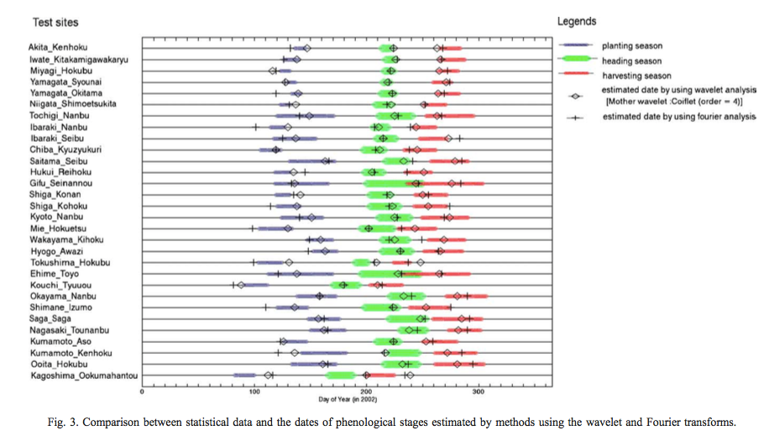
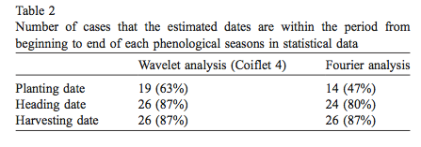
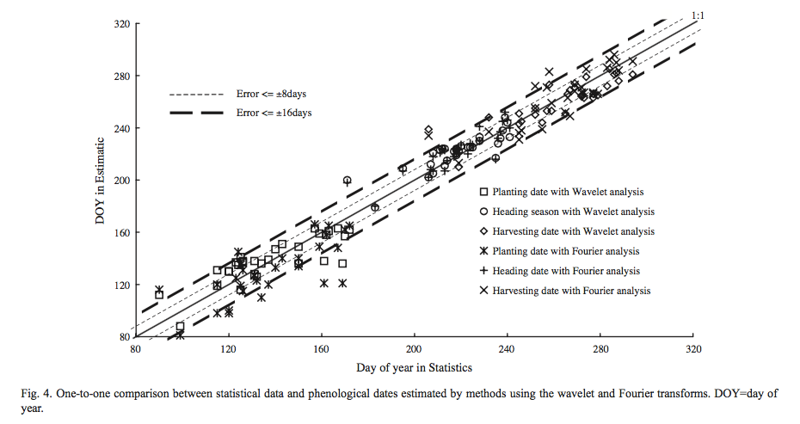
(Sakamoto et al, 2005)
Repeat Fig 4 for growing period (i.e. growing period in data vs growing period in my estimates)
Calculate number of cases (or percent cases) in which estimation error exceeds 16 days
Produce the graphs below
Compare my results to their Table 2

Slide 22
Qual

Slide 23
Form: Higher Degree Committees
Need: exam date
3-5 subject areas (crop modeling, remote sensing, timeseries analysis, causal statistics, land use change)
Committee:
Chair from CEE
ASR (academic senate member) NOT from department
Overall committee must be at least 50% from CEE
Questions about Crop Timing to ask:
How does my estimated peak -> harvest/browndown compare to GDD/thermal time?
For qual, propose the following: (1) plant/harvest date estimation, (2) analyzing plant/harvest date estimation as proxy for farmer behavior over history, (3) something with the statistical crop model.

Slide 24
To Do

Slide 25
To Do – LAI timeseries
Match up Matopiba and CARpolys by farmer name
See if Dave or Jake can upload GOME data. See if Avery gets STAIR information.
explore an approach that lets you use some goodness of fit type metric to let you select your frequency parameter in your harmonic curve fitting scheme.
One key thing is to transition the data cleaning steps to code if you haven’t already. recreate/document the cleaning you already conducted using a code based tool. R would be ideal. This is the best tactics for cleaning data because we it is transparent and allows error tracing
Put in GEE a way to get a sense of the spread in planting, harvest dates and how different pixels look from each other
Fit planting date to onset map for running hypothetical pixels.
Look up pyramiding for continuous vs categorical rasters.
Look at manuscripts for methods, tests that people are doing in plant/harvest estimate, use this to come up with additional questions to ask, methods
Explore adding SIF and other RS data; merging Landsat with MODIS
Look up triple co-location (adding new satellite data to triangulate plant/harvest estimate)

